Slide 1
Hyperspectral Data Classification
Jun Chen, Dan Wang,
Zhou Zhang, Penghao Wang

Slide 2
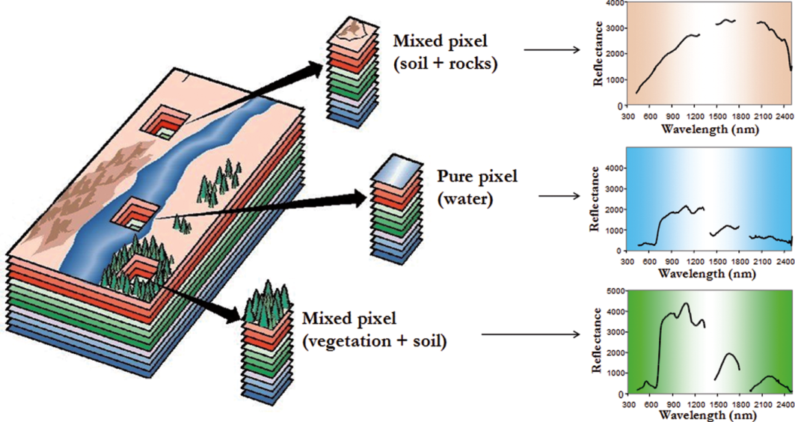
Introduction: hyperspectral image
Spectral domain
  Every pixel represents a continuous spectrum, and different materials have different reflectance at specific wavelengths.
  Detailed spectral information can be helpful for discriminating different objects on the earth.

Slide 3
Related Work
Objective: Hyperspectral image classification is to categorize all pixels in the image into land cover classes based on the spectral features. Several classification algorithms have been used in this field including:
  Maximum likelihood classification
  Neural networks classifier
  Decision trees
  Support Vector Machine (SVM)

Slide 4
Supervised Classifiers
Considering the high dimensionality of the data, we used the following three classifiers:
  Kernel SVM
    Gaussian kernel, cross-validation for parameter selection
  Random Forest
    Use cross validation to select the number of trees and the number of features for each split
  Adaboost
    Use Decision tree as basic classifier and cross-validation for parameter selection

Slide 5
Experiments
Remove noisy spectral bands (features), and use 200 out of 220 as final features.
Ignore minor classes with very labeled samples, and focus on 12 out of 16 classes.
For each class, randomly select 100 labeled samples for training and 100 for testing.
Normalize the data for each feature.
 | Kernel SVM | Random Forest | Adaboost
Overall Accuracy | 0.85 | 0.80 | 0.82
Corn-no till (C1) | 0.72 | 0.68 | 0.71
Corn-min till (C2) | 0.67 | 0.60 | 0.55
Corn (C3) | 0.91 | 0.84 | 0.88
Soybeans-no till (C4) | 0.82 | 0.77 | 0.76
Soybeans-min till (C5) | 0.77 | 0.77 | 0.80
Soybeans-clean till (C6) | 0.78 | 0.66 | 0.70
Grass/Pasture (C7) | 0.95 | 0.91 | 0.95
Grass/Trees (C8) | 0.94 | 0.91 | 0.94
Hay-windrowed (C9) | 0.99 | 0.99 | 0.99
Wheat (C10) | 0.99 | 0.99 | 0.99
Woods (C11) | 0.83 | 0.84 | 0.82
Building-Grass-Trees-Drive (C12) | 0.78 | 0.65 | 0.78

Slide 6
Summary
Kernel SVM is effective for high dimensional data classification.
Cross-validation is useful for parameter selection to avoid overfitting
Using spectral features alone may not maximize the classification performance, spatial features in the image can also be useful and can be tested in the future.

